Slide 1
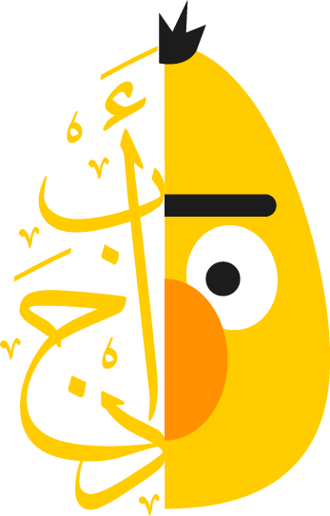



Arabic
Dialect Identification
AIM Technologies
Mohamed Sebaie Sebaie Youssef

Slide 2


Table of Contents
01
Data Fetching
02
03
Machine Learning Approach
Data Preprocessing and Splitting
04
Deep Learning Approach
05
Results
06
Deployment

Slide 3
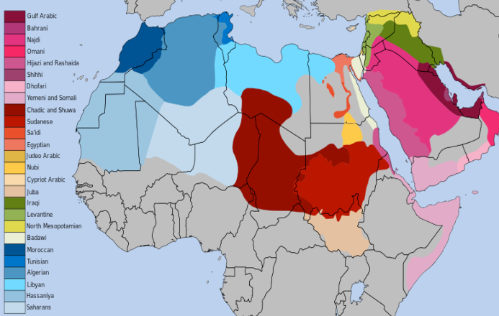
Introduction
Arabic has a widely varying collection of dialects. Many of these dialects remain under-studied due to the rarity of resources.
The goal of AIM task is to classifying the dialect of the tweet writer given the tweet itself.

Slide 4
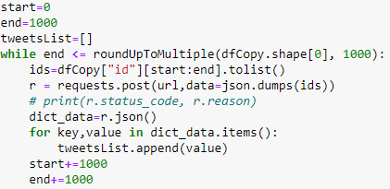
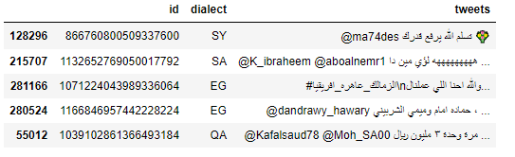
Data Fetching
The dataset has 2 columns, id and dialect.
Target label column is the “dialect”, which has 18 classes.
Then I use The “id” column to retrieve the text by calling this API by a POST request. https://recruitment.aimtechnologies.co/ai-tasks
The API returns a dictionary where the keys are the ids, and the values are the text.

Slide 5
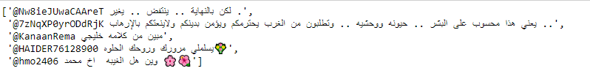
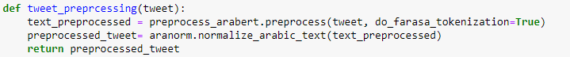
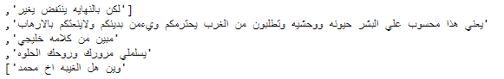
Data Preprocessing

Slide 6
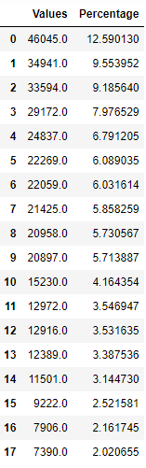
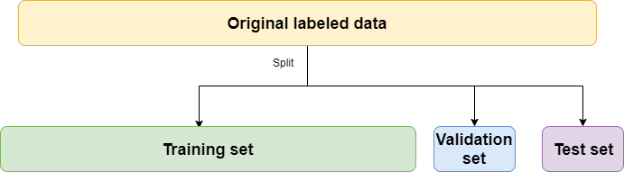

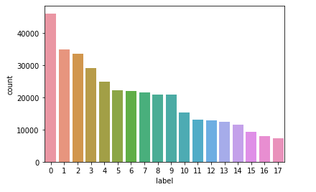
Data Splitting
365723
45715
45716

Slide 7


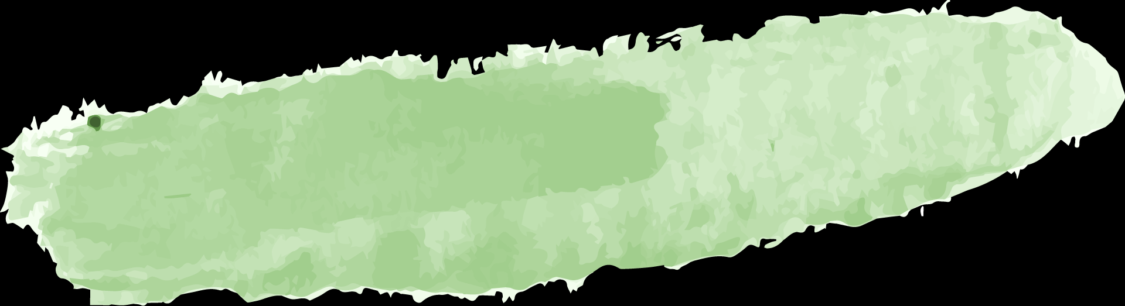

Machine Learning Approach
Naive Bayes Classifier for MultiNomial
Naive Bayes Classifier for BernoulliNB
SGD Classifier
LinearSVC Classifier
TfidfVectorizer
Evaluation
Preprocessing
Models Training
Deployment
Train Accuracy: 0.71
Validation Accuracy : 0.51
Test Accuracy: 0.51
F1 Score: 0.47
Train Accuracy: 0.69
Validation Accuracy : 0.52
Test Accuracy: 0.52
F1 Score: 0.49
Train Accuracy: 0.95
Validation Accuracy : 0.53
Test Accuracy: 0.53
F1 Score: 0.49
Train Accuracy: 1.00
Validation Accuracy : 0.57
Test Accuracy: 0.57
F1 Score: 0.54

Slide 8
AraBERT Transformer
AraBERT is an Arabic pretrained language model based on Google's BERT architecture. AraBERT uses the same BERT-Base config.
AraBERT models evaluated on different downstream tasks and compare them. The Tasks were Sentiment Analysis on 6 different datasets (HARD, ASTD-Balanced, ArsenTD-Lev, LABR), Named Entity Recognition with the ANERcorp, Arabic Question Answering on Arabic-SQuAD and ARCD and recently Arabic Dialect Identification (twitter Data)
I used AraBERTv0.2-Twitter-base/large which are two new models for Arabic dialects and tweets, trained by continuing the pre-training using the MLM task on ~60M Arabic tweets (filtered from a collection on 100M). And fine tuning them on my task.
The two new models have had emojis added to their vocabulary when use arabert pre-processing though i made it with two processing to remove the emojis and any unwanted words.
We can say that The pre-training was done with only 2 epochs and increased from 59 to 61 after 4 epochs then the model overfit and no improving for the accuracy.

Slide 9
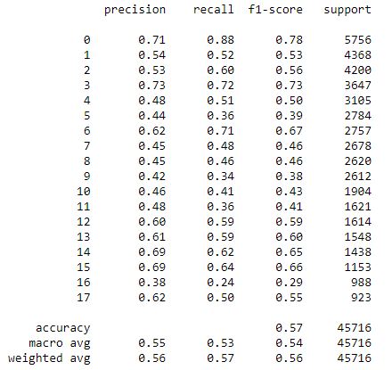
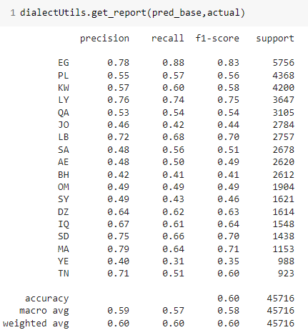
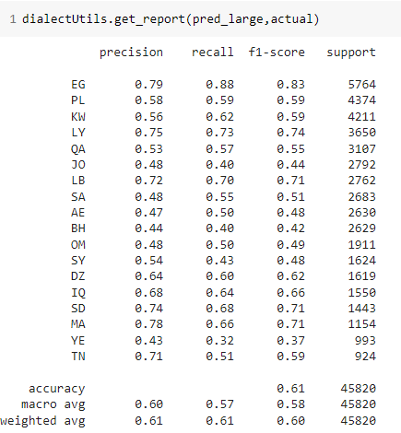
Results
LinearSVC Classifier
4 min Training
BERT Base
4 Hours Training
BERT Large
12.5 Hours Training

Slide 10
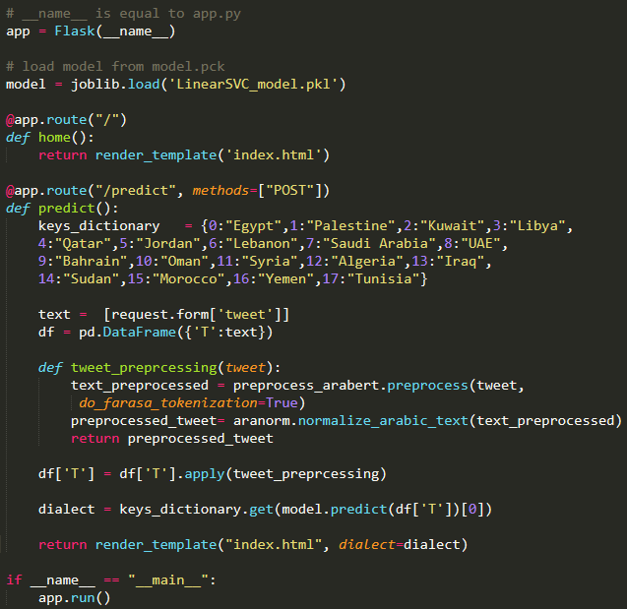
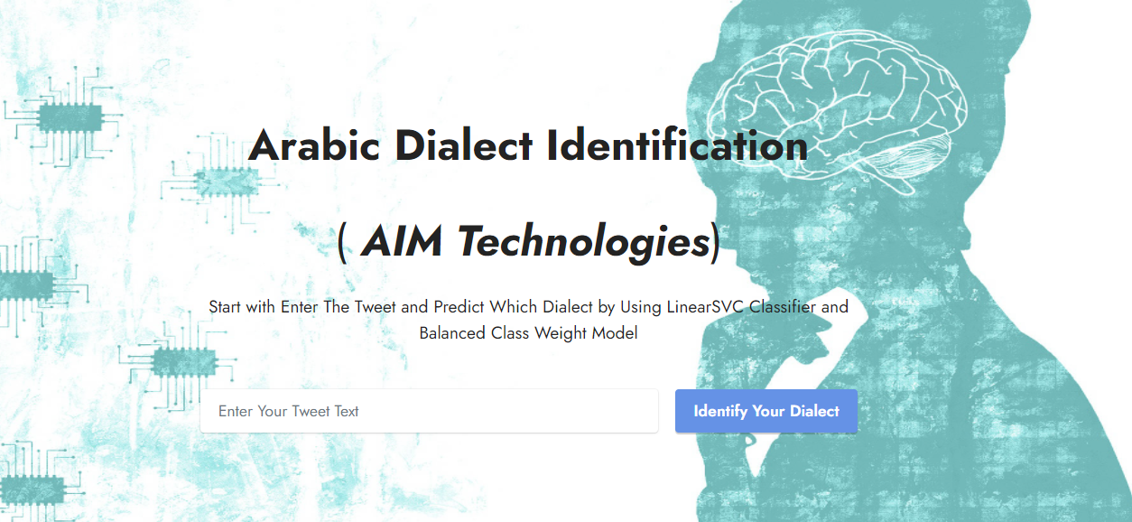
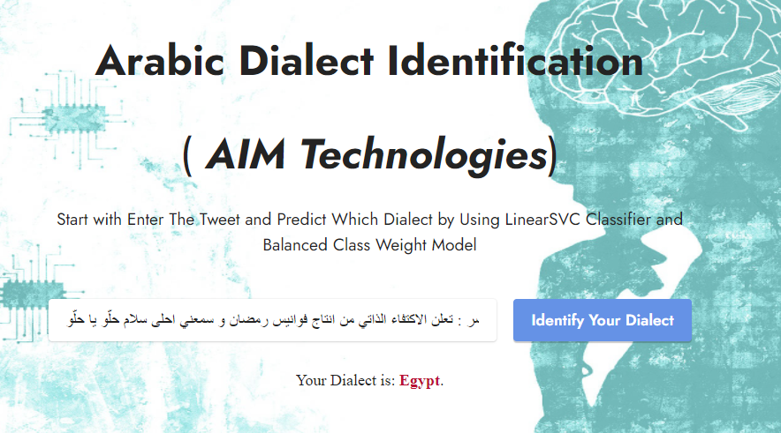
Deployment

Slide 11
References
https://towardsdatascience.com/machine-learning-advancements-in-arabic-nlp-c6982b2f602b
http://mccormickml.com/2019/07/22/BERT-fine-tuning/
https://huggingface.co/aubmindlab/bert-base-arabertv02-twitter

Slide 12
THANKS
Do you have any questions?
mohamedsebaie1@gmail.com
201010805540
https://mohamed-sebaie.herokuapp.com/

